Slide 1
College of Liberal Arts & Science
Scorecard

Slide 2
Data used for this Diversity Scorecard
ADVANCE FADO used the
  2018 Institutional Research Data
  2018 Collaborative on Academic Careers in Higher Education (COACHE) data

Slide 3
Overall Faculty Rank by Race & Sex
at UNC Charlotte
White
Non – White
% of Faculty
Non-White: American Indian or Alaska Native, Non-Hispanic Asian,
Non-Hispanic Black, Hispanic, Nat Hawaiian/Other Pacific Islander,
Two or More Races, Unknown
Male
Female

Slide 4
Overall Faculty Rank by Race & Sex
College of Liberal Arts & - Fall 2018
White
Non – White
% of Faculty
Non-White: American Indian or Alaska Native, Non-Hispanic Asian,
Non-Hispanic Black, Hispanic, Nat Hawaiian/Other Pacific Islander,
Two or More Races, Unknown
Male
Female

Slide 5

Student Demographics by Race/Ethnicity
College of Liberal Arts & Science - Fall 2018
Percentage of Students

Slide 6
Student Demographics by Sex
College of Liberal Arts & Science - Fall 2018
Percentage of students

Slide 7
Climate Data (From COACHE Survey)

Slide 8
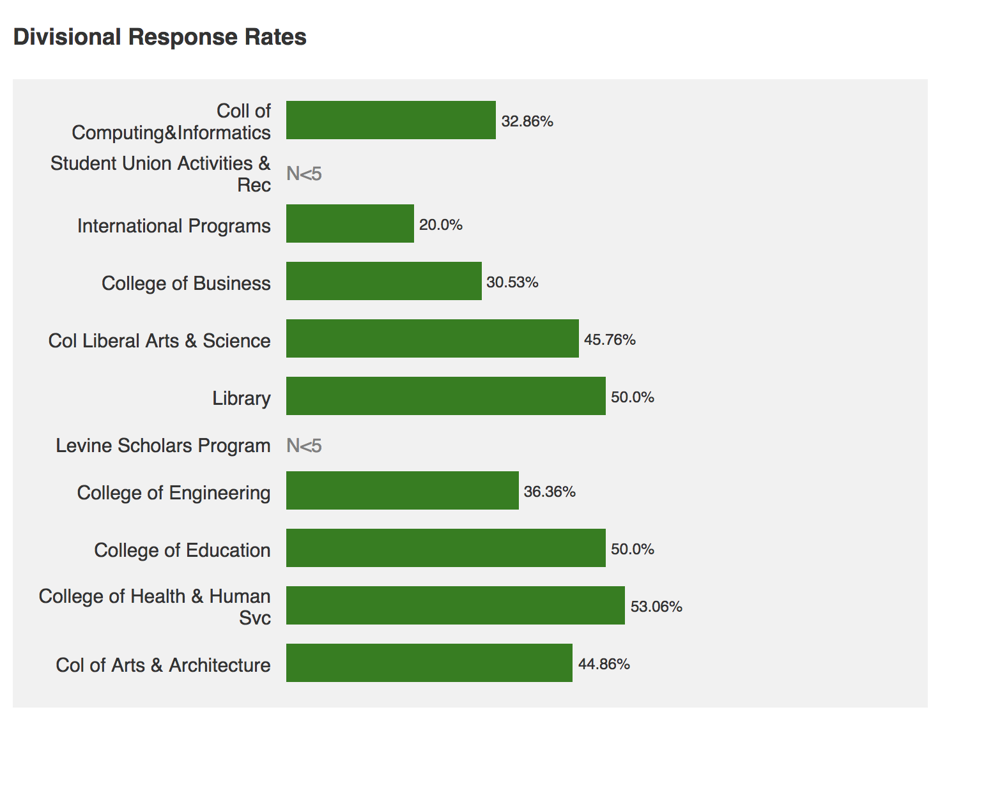

Slide 9
Summary of Benchmarks: ALL FACULTY
Areas of highest satisfaction:
  Facilities and Work Resources, Mentoring
Areas of lowest satisfaction:
  Health and Retirement Benefits, Nature of Work - Teaching
Improved since last survey:
  Majority of benchmarks have improved
Worsened since last survey:
  Leadership:
    Senior
    Faculty
  Governance
    Shared sense of purpose
    Understanding the issue at hand
    Productivity

Slide 10
Summary of Benchmarks: CHHS
Areas of highest satisfaction:
  Facilities and Work Resources, Teaching, Tenure Policies and Dept. Collegiality
Areas of lowest satisfaction:
  Interdisciplinary work; Promotion to Full; Governance
Areas lower than other Colleges:
  Interdisciplinary work; Promotion to Full and Dept. Quality
  Items in green are different from ALL Faculty Data

Slide 11
Divisional Analysis - College of Liberal Arts & Science

Slide 12
Summary of Benchmarks Specific to CLAS
Areas of Strength Humanities:
  Nature of work: Research – Support for research, engaging undergrads in research, pre-award, post-award, support for GAs and travel
  Nature of work: Service – Number of student advisees
  Nature of work: Teaching – number of courses taught, equitability of distribution of teaching load and quality of grad students to support teaching
Areas of lowest satisfaction:
  Expectations for funding, Influence over focus of research, committee number/attractiveness and discretion to choose
  Quality of students taught
  Time spent on outreach

Slide 13
Summary of Benchmarks Specific to CLAS
Humanities
Areas of Strength Humanities:
  Nature of work: Research – Support for research, engaging undergrads in research, pre-award, post-award, support for GAs and travel
  Nature of work: Service – Number of student advisees
  Nature of work: Teaching – number of courses taught, equitability of distribution of teaching load and quality of grad students to support teaching
Areas of Concern Humanities:
  Expectations for funding, Influence over focus of research, committee number/attractiveness and discretion to choose
  Quality of students taught
  Time spent on outreach

Slide 14
Summary of Benchmarks Specific to CLAS
Social Sciences
Areas of Strength Social Sciences:
  Nature of work: Research –engaging undergrads in research
  Nature of work: Service - discretion to choose committees
  Nature of work: Teaching – number of courses taught
  Time spent on administrative tasks
Areas of Concern Social Sciences:
  Quality of grad students to support research, post-ward, support for securing GAs, availability for course release
  Number of student advisees
  Discretion over course content
  Time spent in outreach
  Ability to balance teaching/research/service

Slide 15
Summary of Benchmarks Specific to CLAS
Biological Sciences
Areas of Strength:
  Nature of work: Research – quality of grad students to support research
  Nature of work: Service – equity of committee assignments
Areas of Concern:
  Nature of work: Research – influence over focus of research, quality of grad students to support research, post-award
  Attractiveness of committees, discretion to choose committees
  Discretion over course content, quality of students taught

Slide 16
Summary of Benchmarks Specific to CLAS
Physical Sciences
Areas of Strength Physical Sciences (note this may extend beyond CLAS):
  Nature of work: Research – Time spent on research, expectation for finding external funding, availability of course release for research
  Nature of work: Service – number of student advisees
  Nature of work: Teaching – number of courses taught; number of students in classes taught
Areas of Concern Physical Sciences (note this may extend beyond CLAS):
  Nature of work: Research – time spent on research, Expectations for finding external funding, influence over focus of research, support for engaging undergrads in research, support for securing grad student assistance, support for travel to present/conduct research, availability of course release for research,
  Time spent on service, support for faculty in leadership roles, number of committees, number of student advisees
  Time spent on teaching, number of courses taught, level of courses taught, discretion over course content, equitability of distribution of teaching load
  Time spent on outreach, time spent on administrative tasks, ability to balance teaching/research/service

Slide 17
Summary of Benchmarks by Demographics
Further summaries can not be done for the COACHE data for this college because the departments do not fall under one specific COACHE heading.
As analysis of the data is done in house, more information will be added.

